Slide 1



Fast fully dynamic labelling for distance queries
Muhammad Farhan, Qing Wang, Yu Lin, Brendan McKay
^{VLDB 2022}
汇报人：何智鹏 指导老师：欧阳典

Slide 2
目录
研究背景
算法设计
实验结果
总结与展望

Slide 3
研究背景

Slide 4

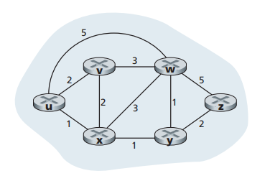
背景介绍
Notes:
https://www.researchgate.net/figure/The-defined-Performance-ased-Standards-PBS-road-network-in-Australia-showing-PBS_fig4_265404087
Road network is a weighted graph. The weight of road can present distance and travel time. It is usually an approximate planar graph

Slide 5
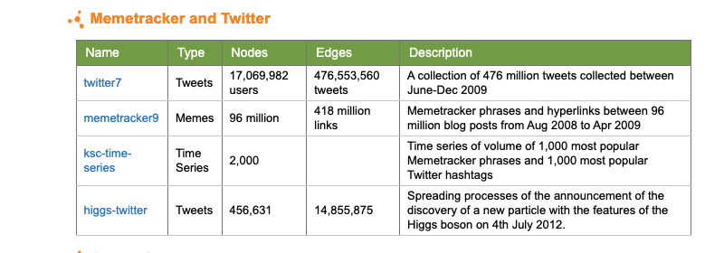
背景介绍
随着社会的高速发展，数据量越来越大，图的结构也越来越大，图形变化的频率也在增大，需要一种适用于大型图网络的动态距离查询算法，在可接受的时空开销内回答最短距离查询。
Notes:
In accommodation-booking services such as Booking and Airbnb, a basic operation is to show several accommodations that are the closest to the location assigned by a user.
In restaurant-review services like Yelp, service providers need to present several restaurants near the user. In taxi-hailing services like Uber, several available vehicles near the pickup location are presented for users before they send the request.

Slide 6
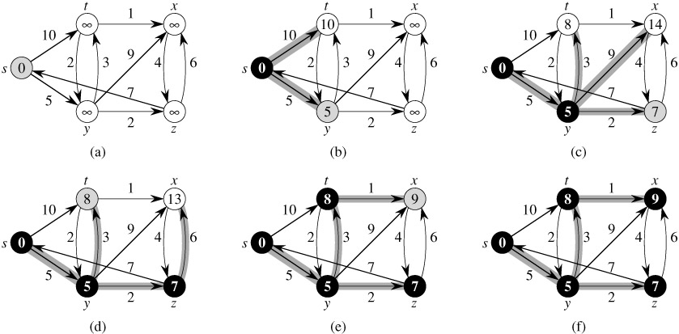
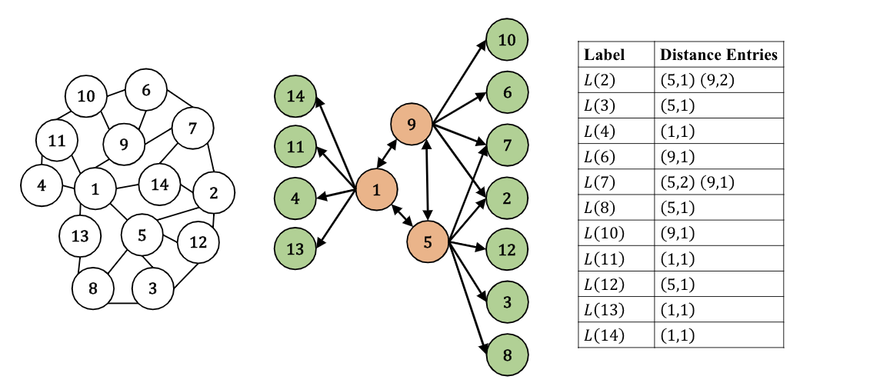
相关研究
最短距离查询
在静态图中，一般有两大类方法来回答最短距离：
1. 不基于索引的方法，直接用搜索算法对图进行搜索。如BFS，Dijkstra。
2. 基于索引的方法。预先将图的顶点信息以索引的形式储存下来，查询时通过简单计算便可得出结果。如图(b)，图的索引形式为最短距离标签。
给一个图G，它包含顶点u，v
图a. Dijkstra算法
图b. HL算法
Notes:
In accommodation-booking services such as Booking and Airbnb, a basic operation is to show several accommodations that are the closest to the location assigned by a user.
In restaurant-review services like Yelp, service providers need to present several restaurants near the user. In taxi-hailing services like Uber, several available vehicles near the pickup location are presented for users before they send the request.

Slide 7
相关研究
最短距离查询
在静态图中，一般有两大类方法来回答最短距离：
静态图的最短距离查询框架HL^{[1]}:
1.构建highway cover label，选择几个顶点作为landmark。
2.计算顶点对经过landmark的最短距离上界d1。
3.使用BFS计算不经过landmark的最短距离d2，比较d1、d2得到最终最短距离。
1. 不基于索引的方法，直接用搜索算法对图进行搜索。如BFS，Dijkstra。
2. 基于索引的方法。预先将图的顶点信息以索引的形式储存下来，查询时通过简单计算便可得出结果。如图(b)，图的索引形式为最短距离标签。
图a. Dijkstra算法
图b. HL算法
[1] Farhan, M., Wang, Q., Lin, Y., McKay, B.D.: A highly scalable labelling approach for exact distance queries in complex networks.In: 22nd International Conference on Extending Database Tech-nology EDBT, pp. 13–24 (2019)
Notes:
In accommodation-booking services such as Booking and Airbnb, a basic operation is to show several accommodations that are the closest to the location assigned by a user.
In restaurant-review services like Yelp, service providers need to present several restaurants near the user. In taxi-hailing services like Uber, several available vehicles near the pickup location are presented for users before they send the request.

Slide 8
背景介绍
动态图
动态图指的是，图G经过插入本身不存在的边，或者删除本身存在的边，变成一个新图G’。图的拓扑结构发生变化，导致顶点对之间的距离可能发生变化，如顶点对（2,5）的最短距离。
1
0
4
3
5
2
7
6
8
10
12
9
11
13
14
插入(2,5)
删除(2,5)
Notes:
In accommodation-booking services such as Booking and Airbnb, a basic operation is to show several accommodations that are the closest to the location assigned by a user.
In restaurant-review services like Yelp, service providers need to present several restaurants near the user. In taxi-hailing services like Uber, several available vehicles near the pickup location are presented for users before they send the request.

Slide 9
背景介绍
动态图
动态图指的是，图G经过插入本身不存在的边，或者删除本身存在的边，变成一个新图G’。图的拓扑结构发生变化，导致顶点对之间的距离可能发生变化，如顶点对（2,5）的最短距离。
1
0
1
0
4
3
4
3
2
插入(2,5)
2
5
5
7
6
7
6
8
10
8
10
12
9
11
删除(2,5)
12
9
11
13
14
13
14
如果把动态图变化过程按变化时刻进行划分，任意两个相邻时刻内，图一定是静态图。
图发生变化，只有标签的内容随之改变，标签的结构和计算最短距离的方法没有改变。
插入(2,5)
删除(2,5)
Notes:
In accommodation-booking services such as Booking and Airbnb, a basic operation is to show several accommodations that are the closest to the location assigned by a user.
In restaurant-review services like Yelp, service providers need to present several restaurants near the user. In taxi-hailing services like Uber, several available vehicles near the pickup location are presented for users before they send the request.

Slide 10
背景介绍
动态图
动态图指的是，图G经过插入本身不存在的边，或者删除本身存在的边，变成一个新图G’。图的拓扑结构发生变化，导致顶点对之间的距离可能发生变化，如顶点对（2,5）的最短距离。个图G包含顶点u，v
1
0
1
0
4
3
4
3
2
插入(2,5)
2
5
5
7
6
7
6
8
10
8
10
12
9
11
删除(2,5)
12
9
11
13
14
13
14
代价太大了
因为一次小的改变就会重新计算整个图
Notes:
In accommodation-booking services such as Booking and Airbnb, a basic operation is to show several accommodations that are the closest to the location assigned by a user.
In restaurant-review services like Yelp, service providers need to present several restaurants near the user. In taxi-hailing services like Uber, several available vehicles near the pickup location are presented for users before they send the request.

Slide 11
Fast full dynamic labelling（全动态标签）

Slide 12
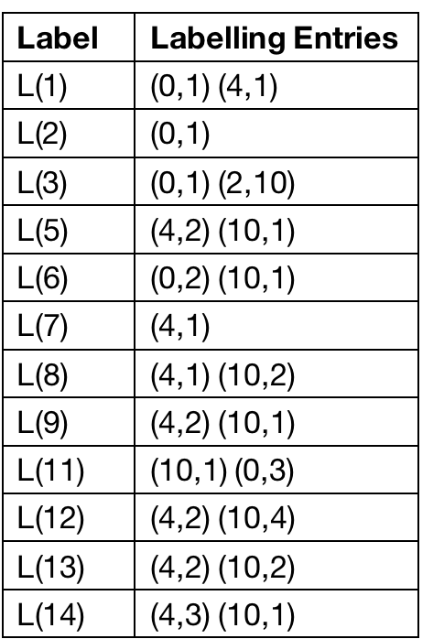
算法设计
全动态标签算法
IncHL算法：一条边插入后，更新受到影响的顶点的距离标签label。
DecHL算法：一条边删除后，更新受到影响的顶点的距离标签label。
定义
边插入：插入边(a, b)到图G，要满足 ，边删除反之同理。
highway cover label：由H和L组成。H中包含landmark集合，以及landmark之间的最短距离索引。L中包含所有顶点到landmark的最短距离标签。
1
0
4
3
0
2
2
5
3
7
6
4
L
8
10
3
12
9
11
10
13
14
H
Notes:
In accommodation-booking services such as Booking and Airbnb, a basic operation is to show several accommodations that are the closest to the location assigned by a user.
In restaurant-review services like Yelp, service providers need to present several restaurants near the user. In taxi-hailing services like Uber, several available vehicles near the pickup location are presented for users before they send the request.

Slide 13
算法设计
动态图更新方案
整体思路：每次只更新所有顶点到任意一个landmark的最短距离标签，直到所有landmark都被更新完。对任意landmark的一次标签更新过程如下图。
受影响的顶点
如果顶点v到landmark(r)的新距离小于等于旧距离，v是受影响的顶点。
v是受影响的顶点，当且仅当图G变成G’时，v到landmark的最短路径集合发生改变。
1
0
4
3
5
2
6
8
10
9
在受影响的点中，离landmark最近的那个点被称为锚点。
Notes:
In accommodation-booking services such as Booking and Airbnb, a basic operation is to show several accommodations that are the closest to the location assigned by a user.
In restaurant-review services like Yelp, service providers need to present several restaurants near the user. In taxi-hailing services like Uber, several available vehicles near the pickup location are presented for users before they send the request.

Slide 14
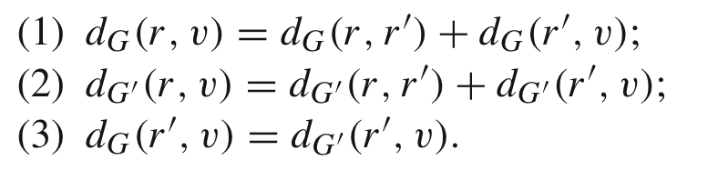
算法设计
剪枝
强剪枝：满足123，无论边增加还是删除，最短路径都需要经过其他landmark，且顶点到其他landmark的距离也没有变化，不需要对顶点做任何更新。
弱剪枝：满足23，因为边增加，新增一条距离不变且经过其他landmark的最短路径，且顶点到其他landmark的距离没有变化，不需要对顶点做任何更新。
1
0
0
4
3
5
2
2
5
5
6
8
8
10
10
强剪枝
弱剪枝
Notes:
In accommodation-booking services such as Booking and Airbnb, a basic operation is to show several accommodations that are the closest to the location assigned by a user.
In restaurant-review services like Yelp, service providers need to present several restaurants near the user. In taxi-hailing services like Uber, several available vehicles near the pickup location are presented for users before they send the request.

Slide 15
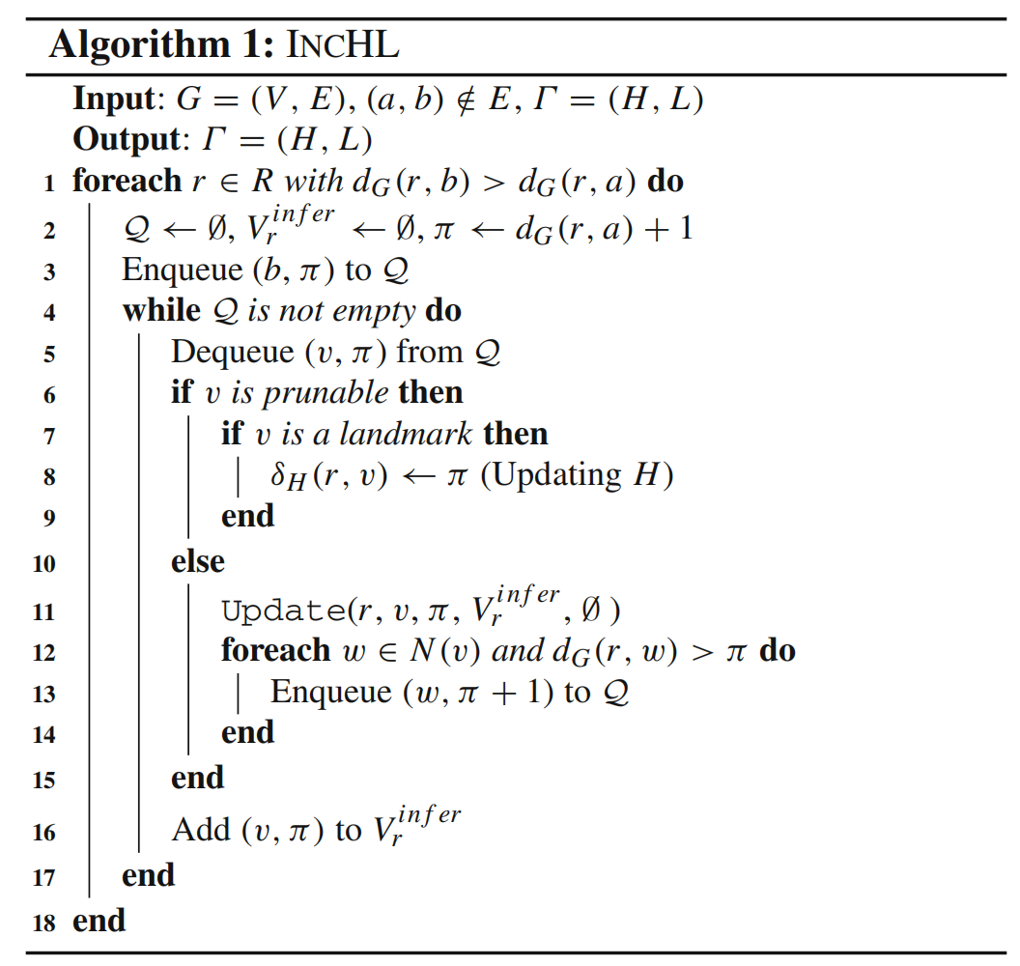
算法设计
IncHL
顶点 | 到0的最短距离
5
8
9
10
13
14
4
6
11
4
2
1
0
3
4
3
2
4
5
3
7
6
3
8
10
4
12
9
11
4
13
14
2
2
3
Notes:
In accommodation-booking services such as Booking and Airbnb, a basic operation is to show several accommodations that are the closest to the location assigned by a user.
In restaurant-review services like Yelp, service providers need to present several restaurants near the user. In taxi-hailing services like Uber, several available vehicles near the pickup location are presented for users before they send the request.

Slide 16
算法设计
DecHL
IncHL：如果顶点v到landmark(r)的新距离小于等于旧距离，v是受影响的顶点。
DecHL：如果顶点v到landmark(r)的最短距离大于等于经过(a,b)边的最短距离，v是受影响的顶点。
1
0
0
4
3
3
5
2
5
2
6
6
8
10
10
9
事实1: 边插入后，顶点到landmark的最短距离可能不变或者减小。
事实2: 边删除后，顶点到landmark的最短距离可能不变或者增大。
定理：删除边(a,b)后，如果v是受影响的顶点，那么原图G中v到r必然存在经过(a,b)的最短路径。
Notes:
In accommodation-booking services such as Booking and Airbnb, a basic operation is to show several accommodations that are the closest to the location assigned by a user.
In restaurant-review services like Yelp, service providers need to present several restaurants near the user. In taxi-hailing services like Uber, several available vehicles near the pickup location are presented for users before they send the request.

Slide 17
算法设计
DecHL-FirstBFS
1
0
4
3
5
2
7
6
8
10
12
9
11
13
14
Notes:
In accommodation-booking services such as Booking and Airbnb, a basic operation is to show several accommodations that are the closest to the location assigned by a user.
In restaurant-review services like Yelp, service providers need to present several restaurants near the user. In taxi-hailing services like Uber, several available vehicles near the pickup location are presented for users before they send the request.

Slide 18
算法设计
DecHL-SecondBFS
顶点 | 到0的最短距离
5
8
9
10
13
14
1
0
2
4
3
4
5
2
3
7
6
4
8
10
4
12
11
3
9
4
13
14
4
Notes:
In accommodation-booking services such as Booking and Airbnb, a basic operation is to show several accommodations that are the closest to the location assigned by a user.
In restaurant-review services like Yelp, service providers need to present several restaurants near the user. In taxi-hailing services like Uber, several available vehicles near the pickup location are presented for users before they send the request.

Slide 19
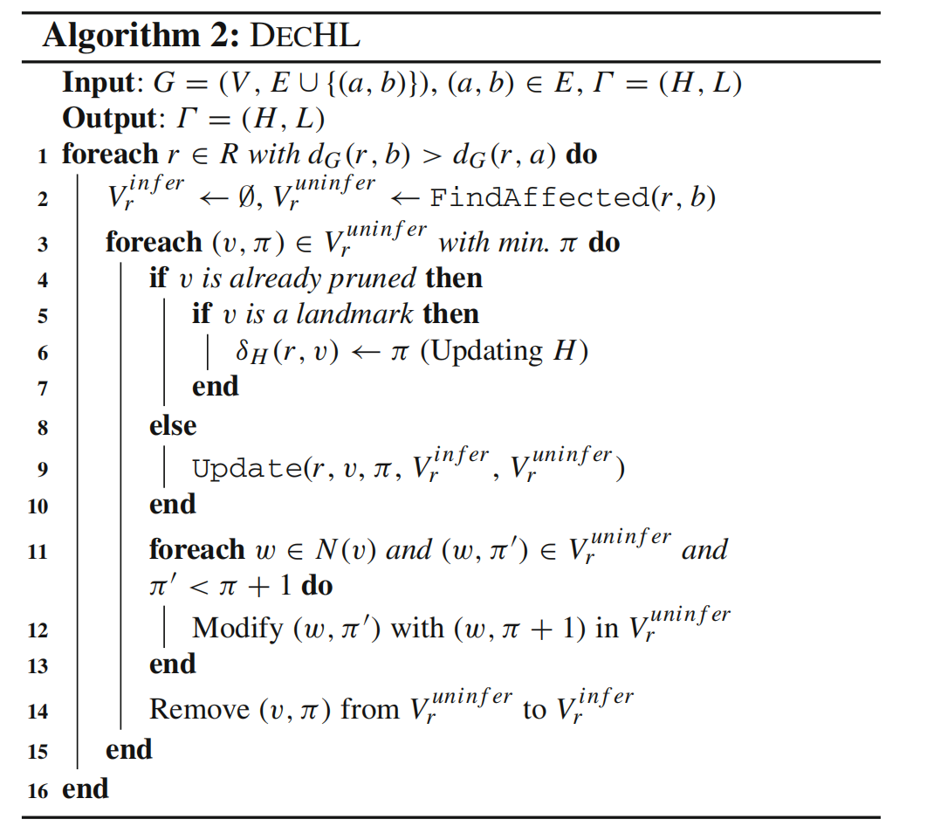
算法设计
DecHL-SecondBFS
Notes:
In accommodation-booking services such as Booking and Airbnb, a basic operation is to show several accommodations that are the closest to the location assigned by a user.
In restaurant-review services like Yelp, service providers need to present several restaurants near the user. In taxi-hailing services like Uber, several available vehicles near the pickup location are presented for users before they send the request.

Slide 20
实验结果

Slide 21
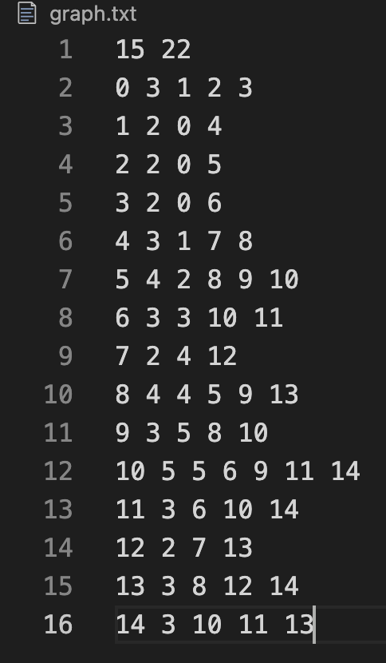


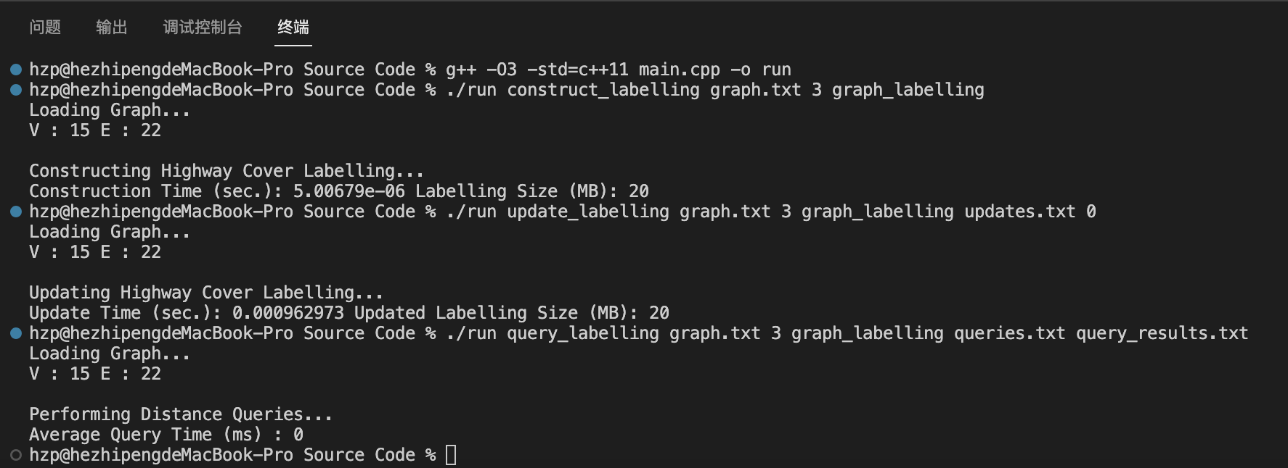
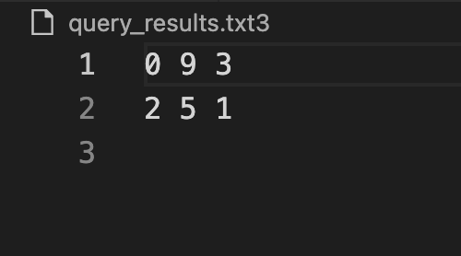
实验结果
1
0
4
3
5
2
7
6
8
10
12
9
11
13
14

Slide 22
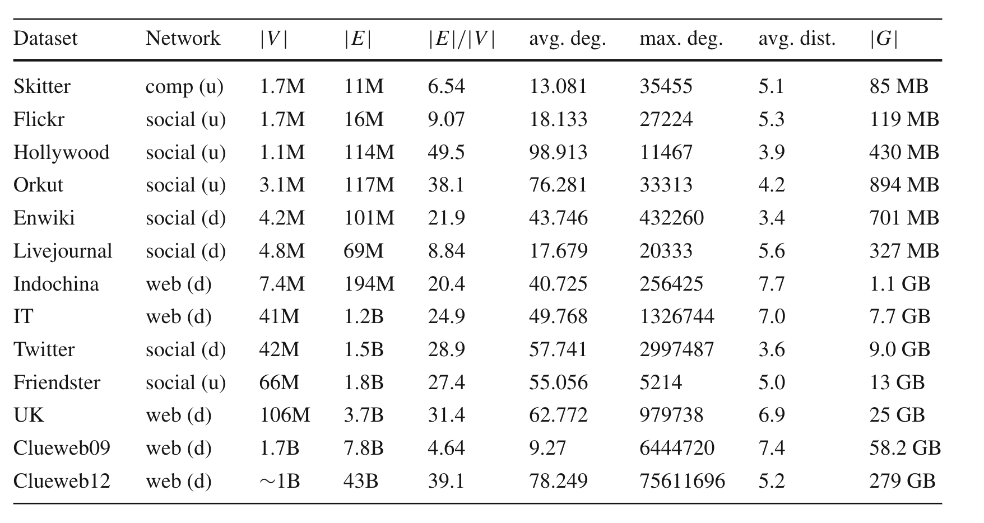
实验结果
数据集

Slide 23
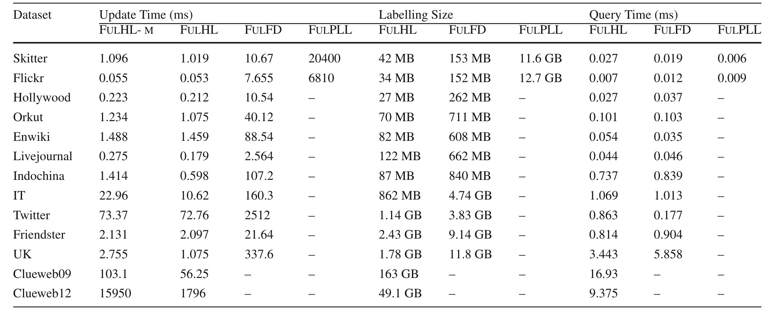
实验结果
全动态算法性能比较
注：- 代表该方法无法在24小时内获得结果或运行内存超过512G。

Slide 24
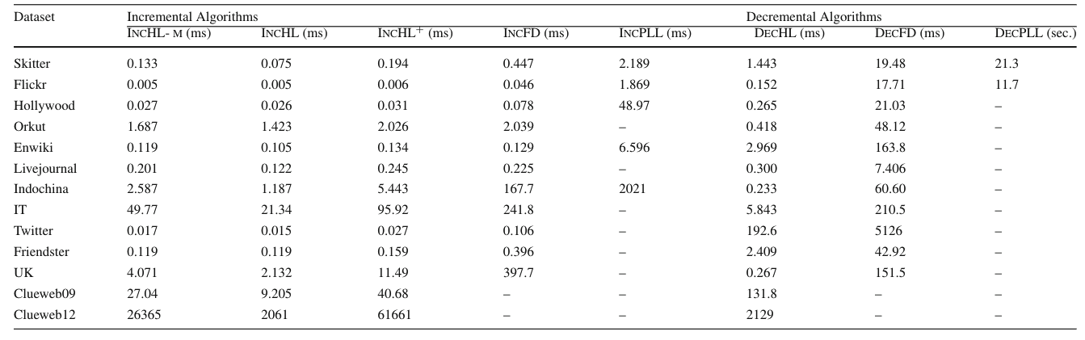
实验结果
插入、删除算法的更新时间

Slide 25
总结

Slide 26
总结
先提出高效的静态图距离查询框架，在此基础上发展到动态图的距离查询；
在大图上做动态的最短距离查询性能优于以前的算法；
算法可以很好的拓展到有向图和带权图中了；
顶会的论文不一定完美无瑕，要带有质疑的眼光去阅读，多和导师组员沟通。
下一步的工作：
研究图中关键顶点的选取，来加速路径的查询；
研究处理批量更新，它们如何影响标签的结构，并将这种影响与单独采取的操作进行比较；
阅读相关文献，了解其他动态图查询的策略。

Slide 27
Thank you!

